Slide 1
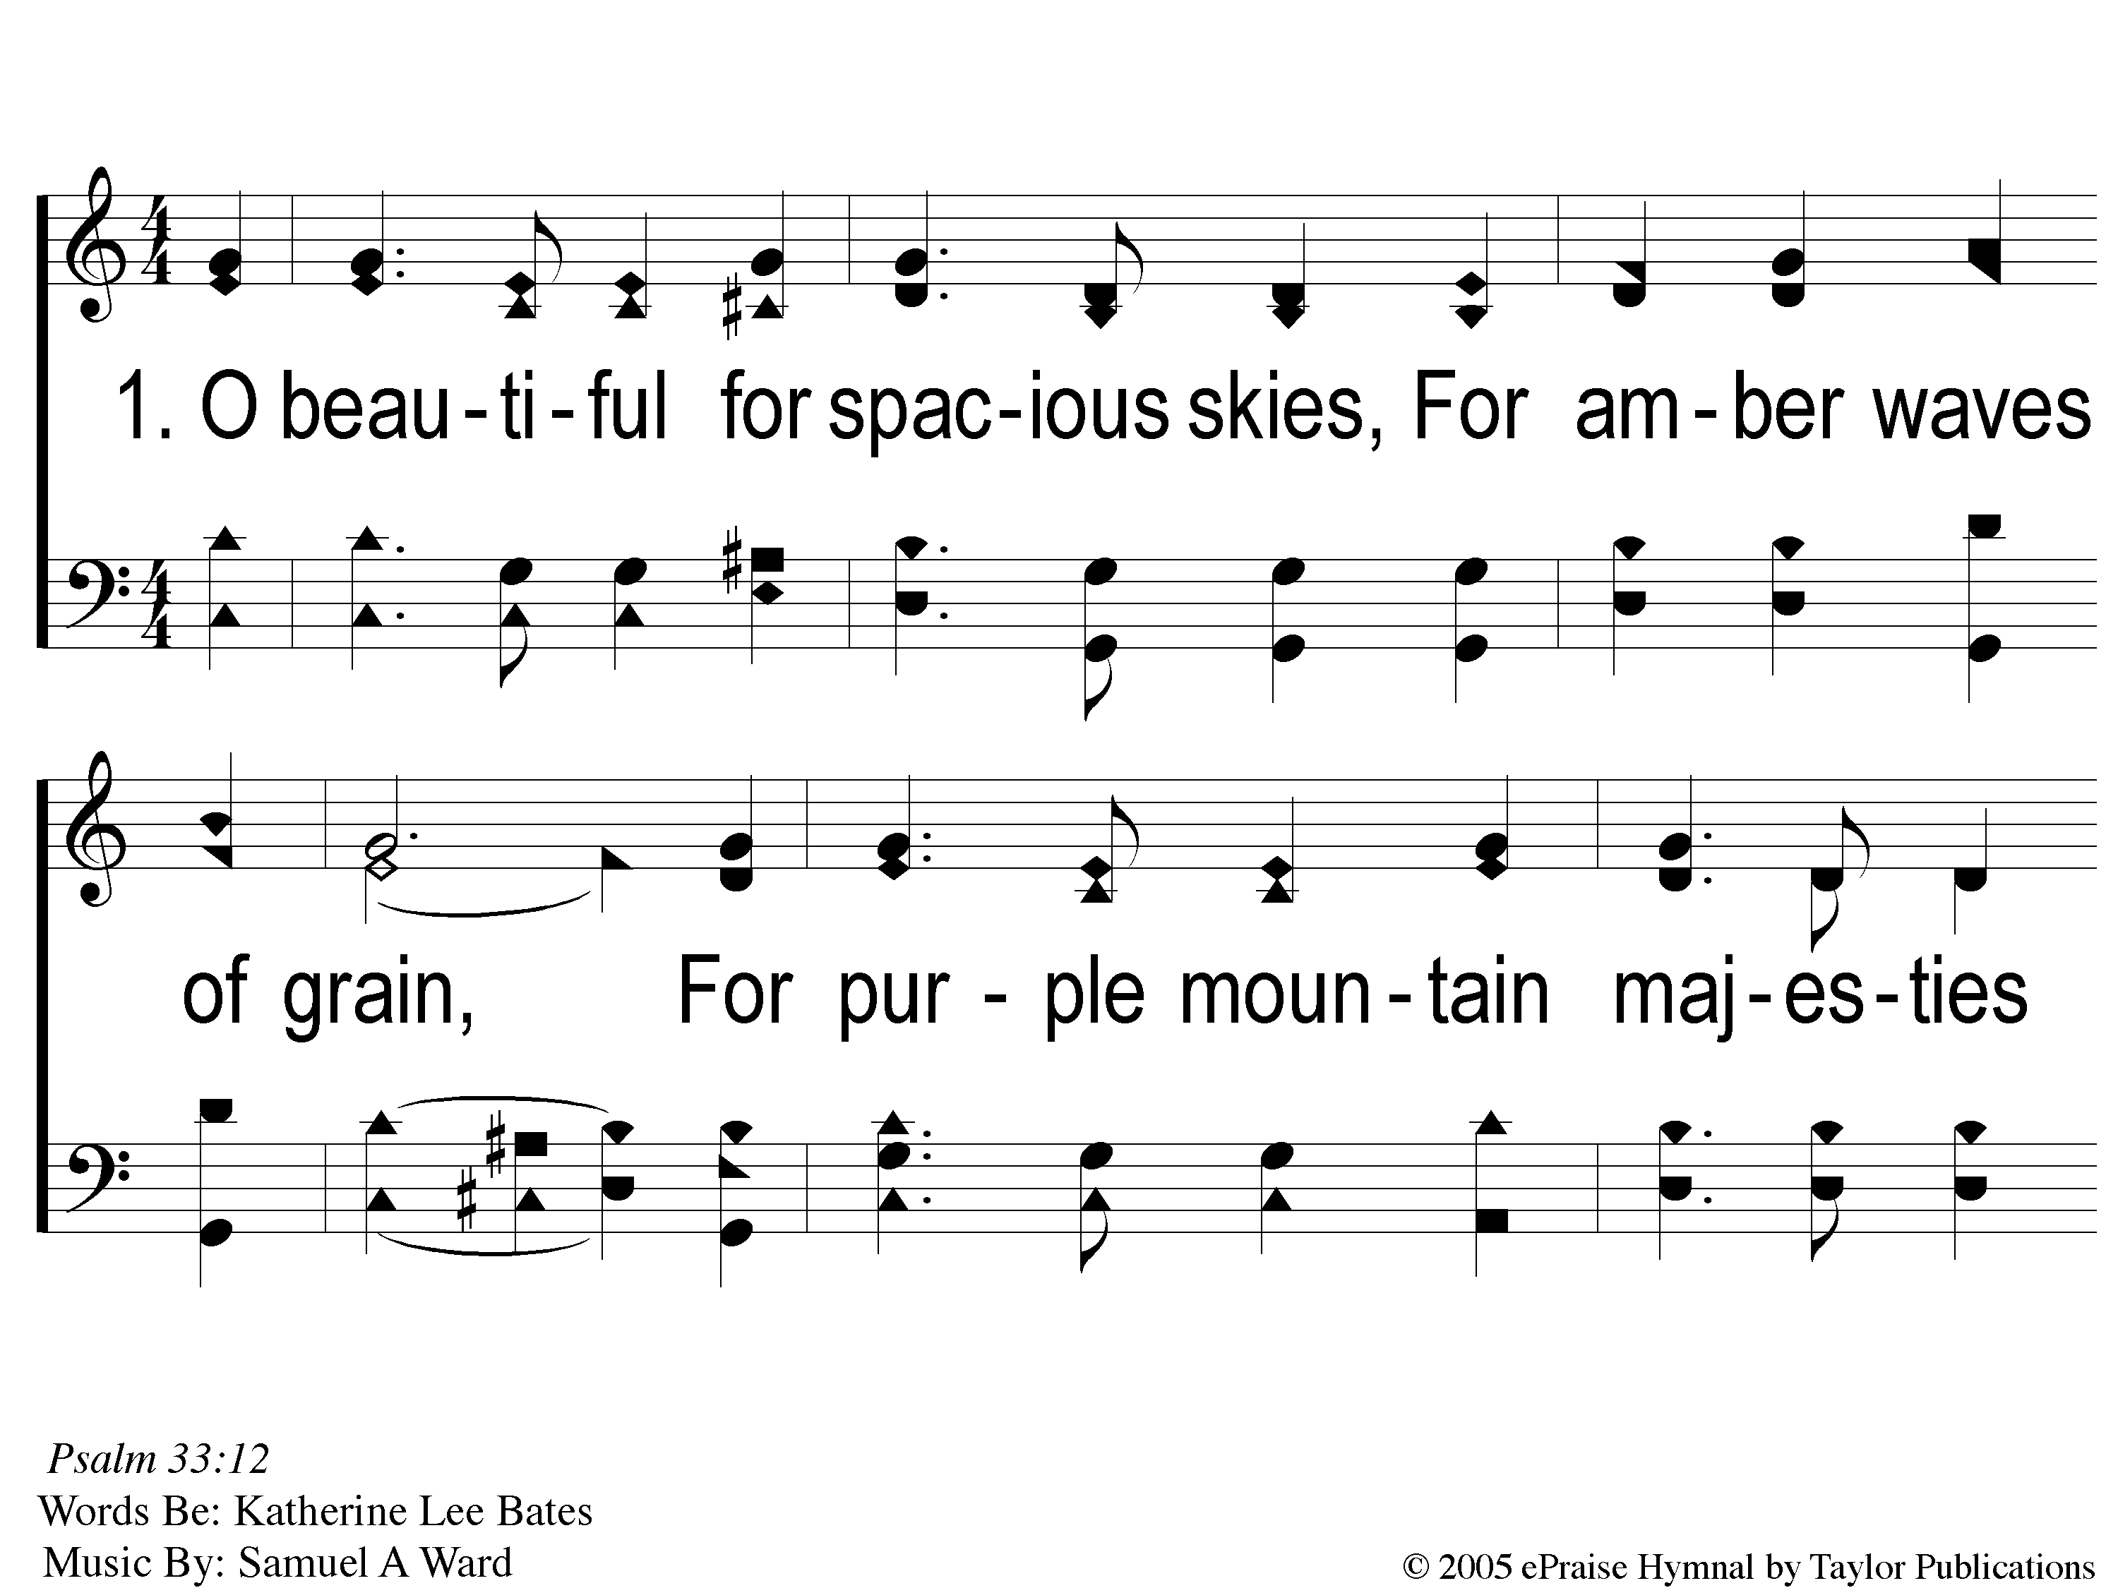
1-1 America The Beautiful
America The Beautiful
1007

Slide 2
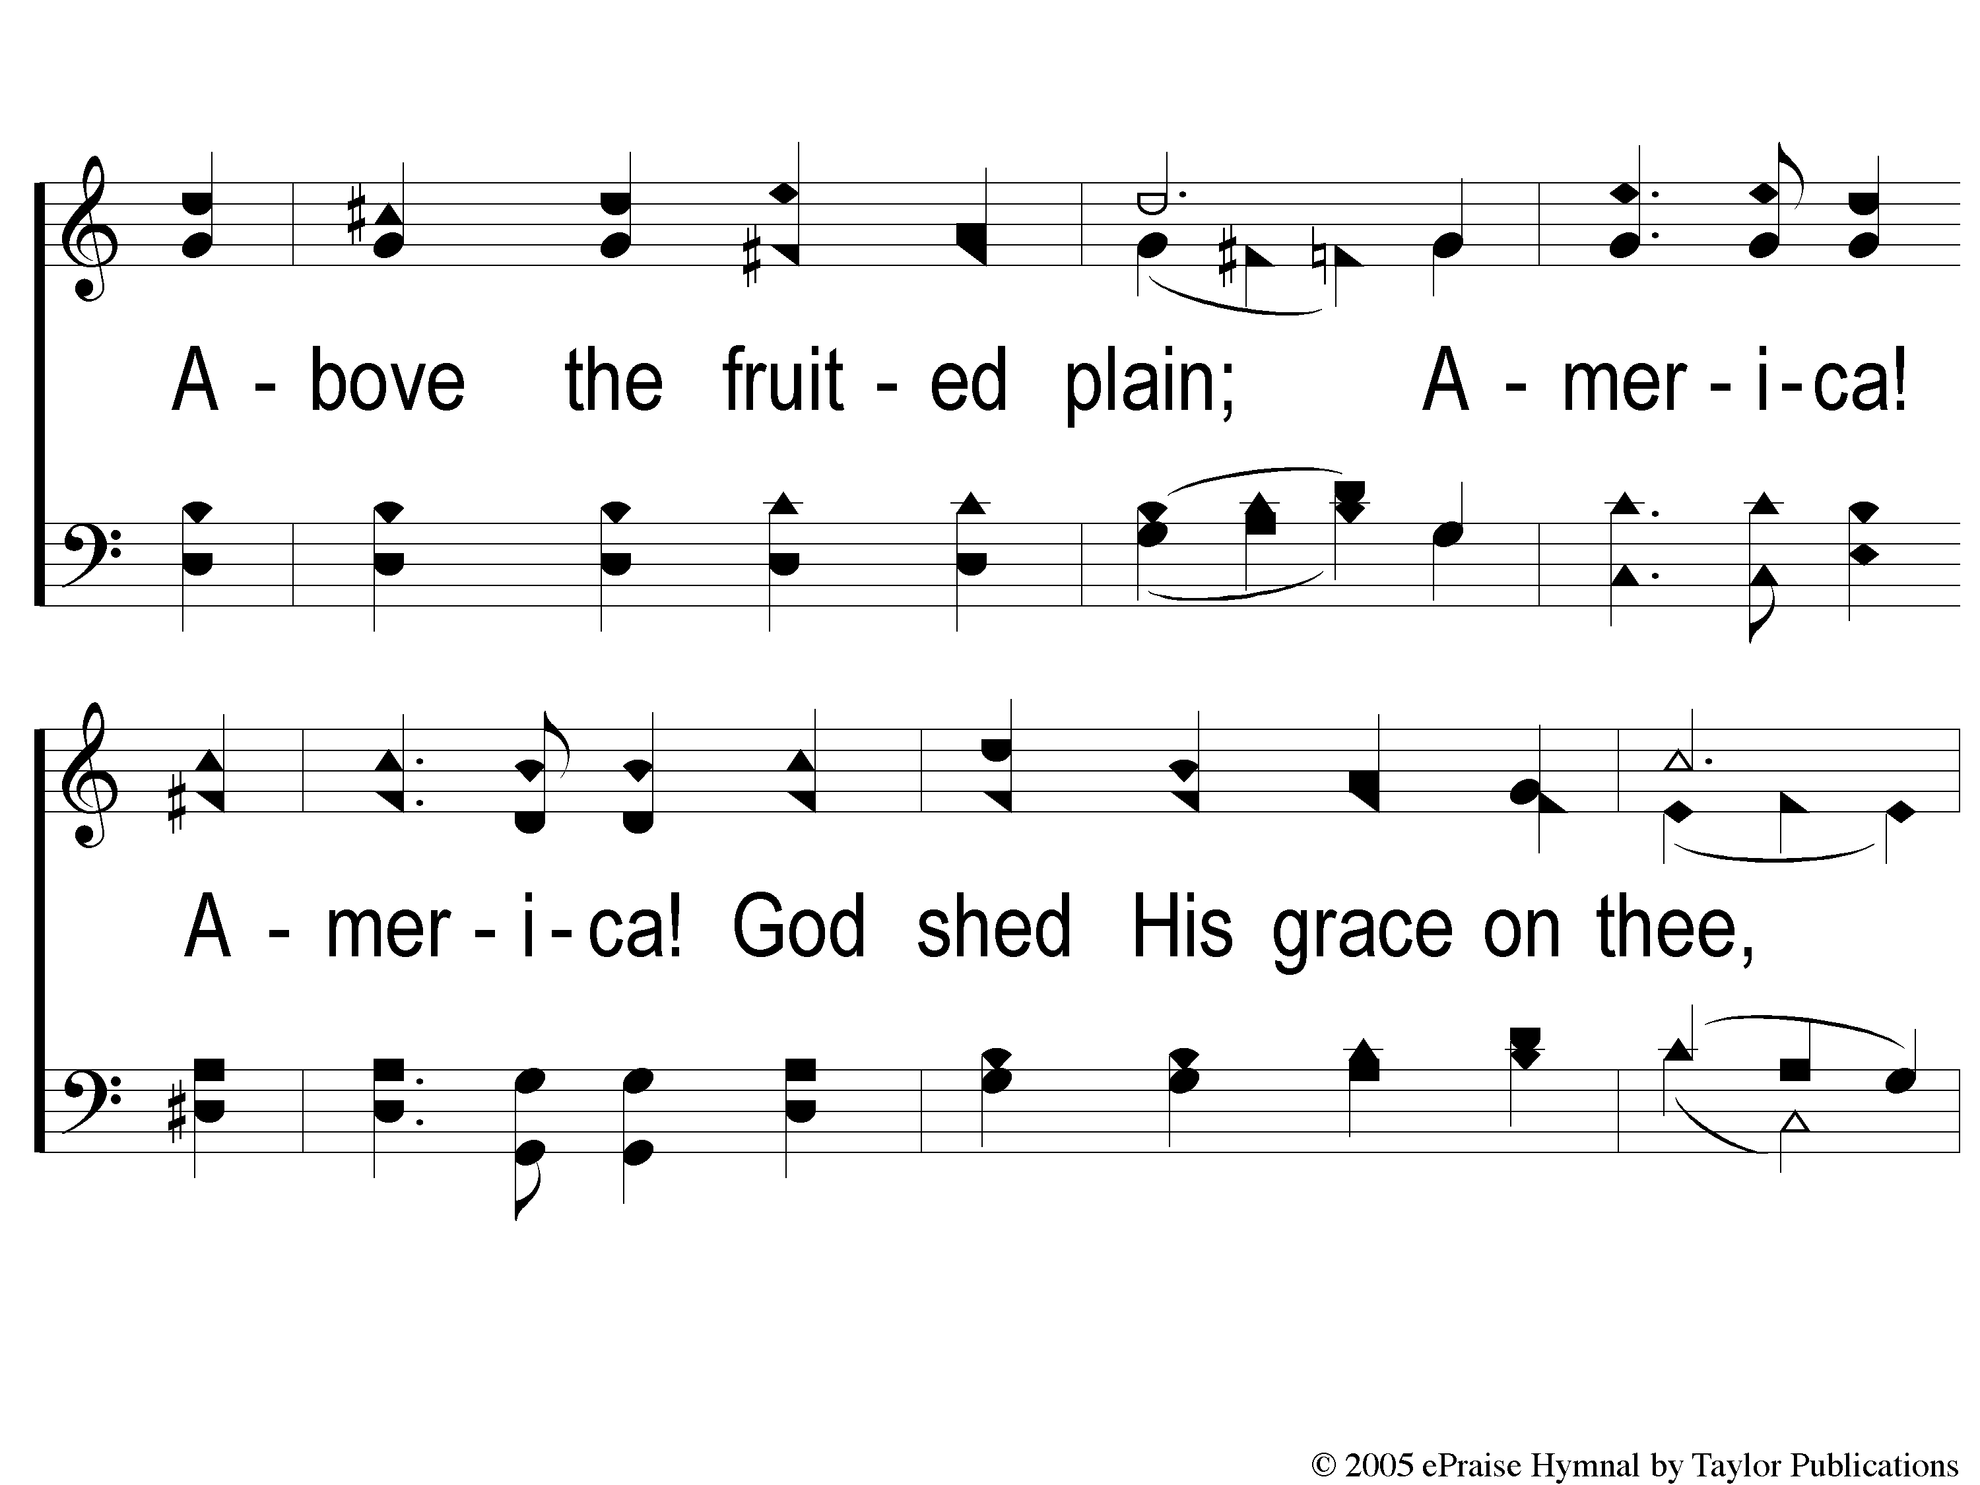
1-2 America The Beautiful
America The Beautiful
1007

Slide 3
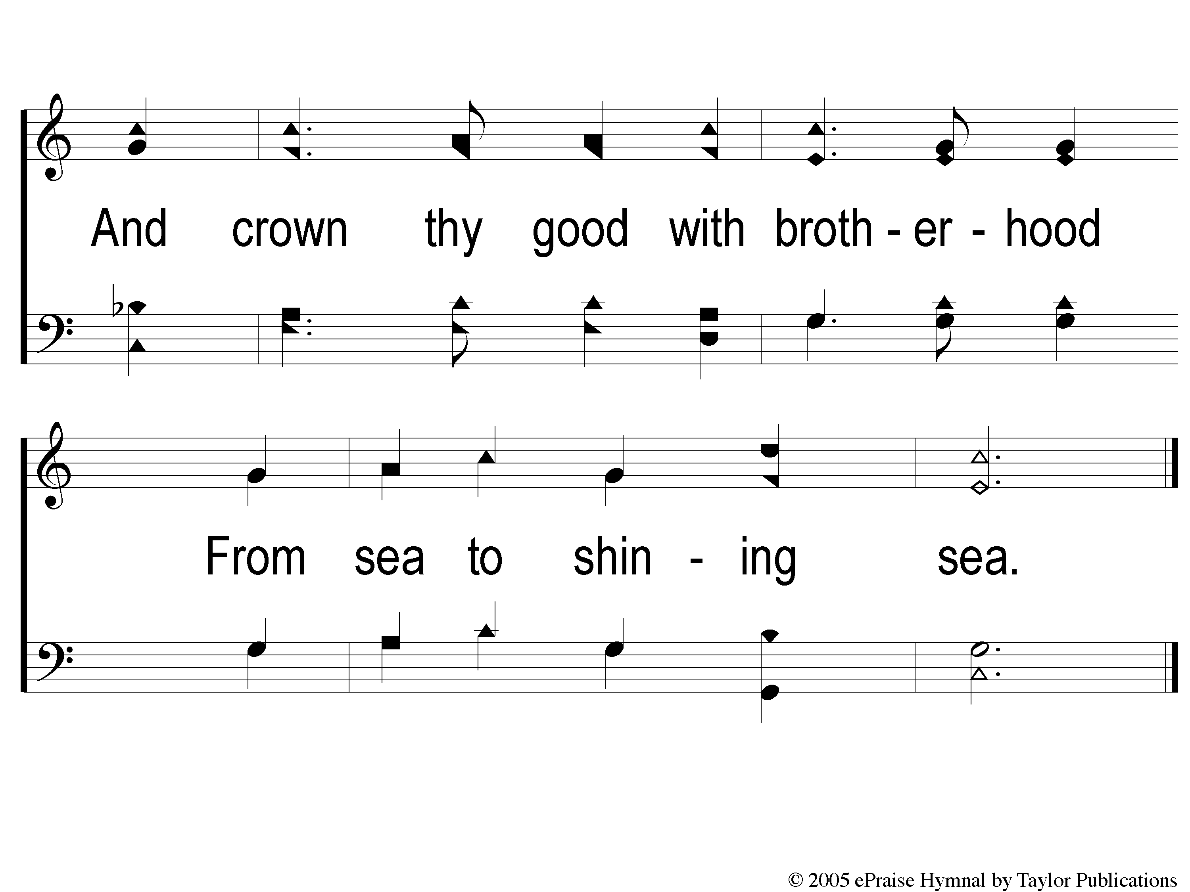
1-3 America The Beautiful
America The Beautiful
1007

Slide 4
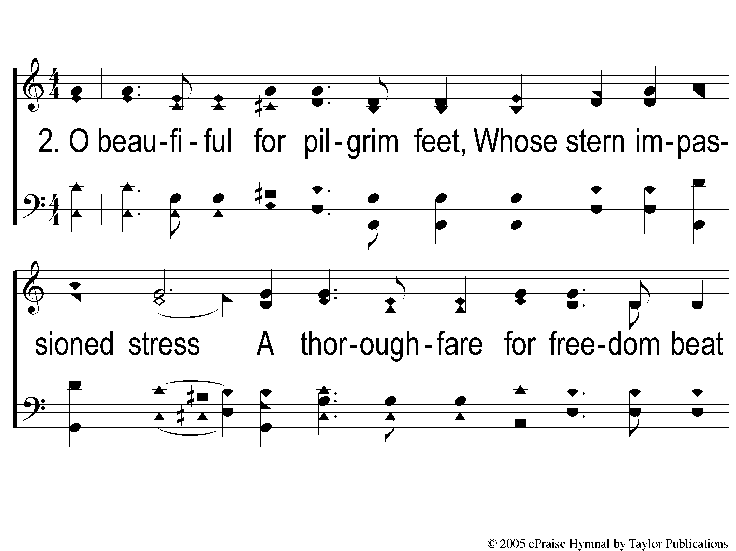
2-1 America The Beautiful
America The Beautiful
1007

Slide 5
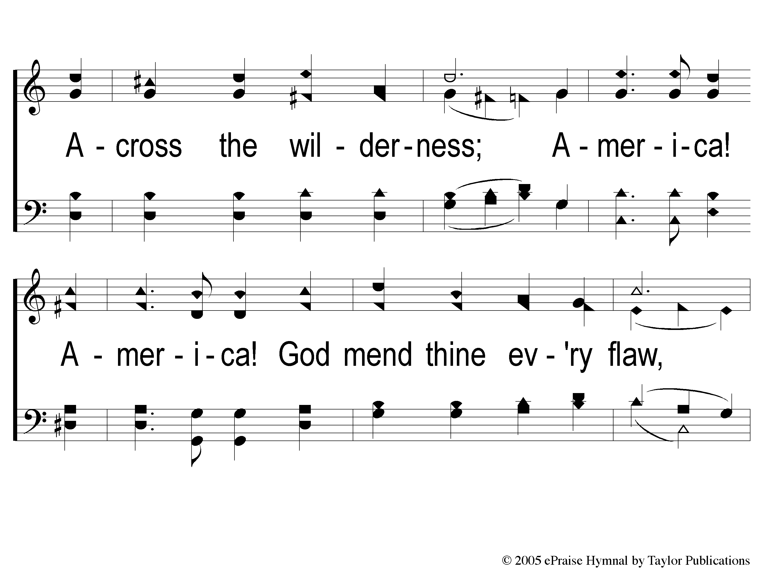
2-2 America The Beautiful
America The Beautiful
1007

Slide 6
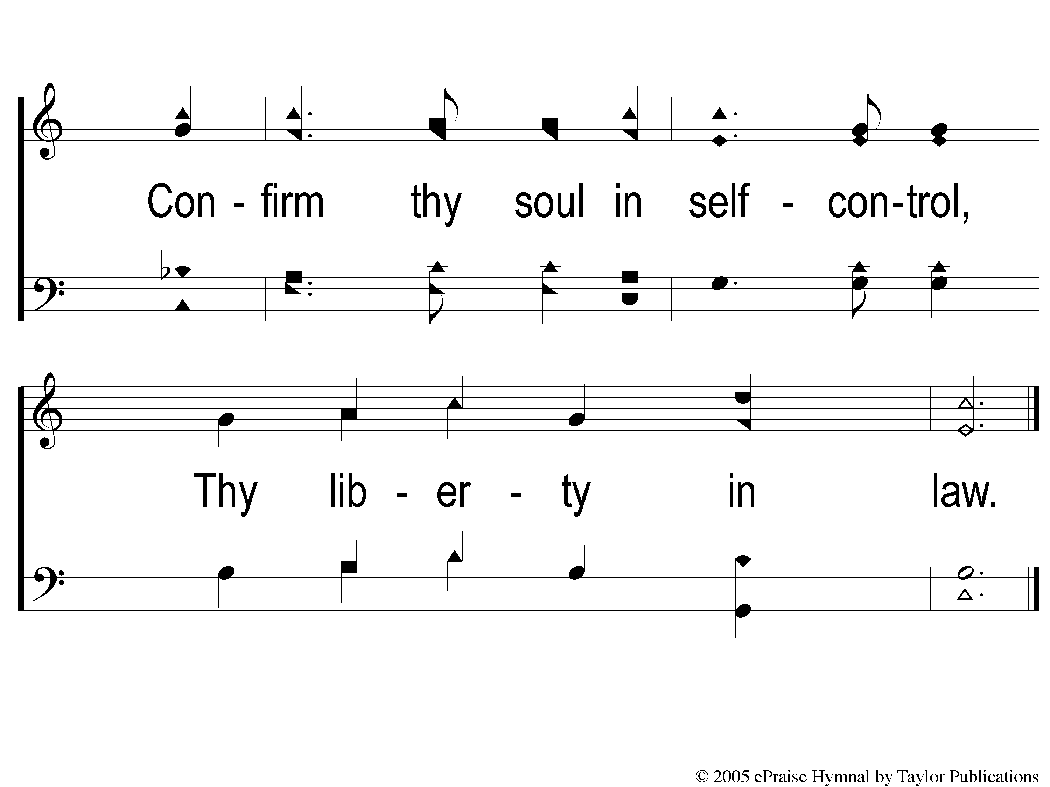
2-3 America The Beautiful
America The Beautiful
1007

Slide 7
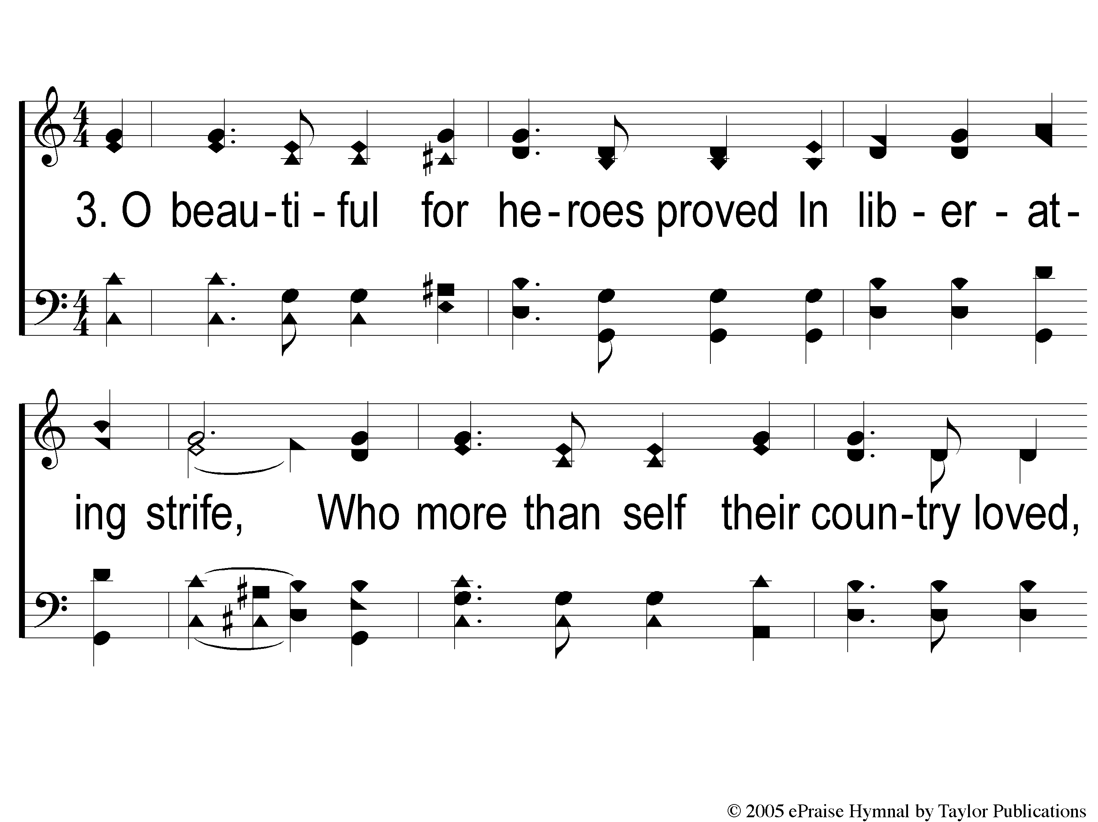
3-1 America The Beautiful
America The Beautiful
1007

Slide 8
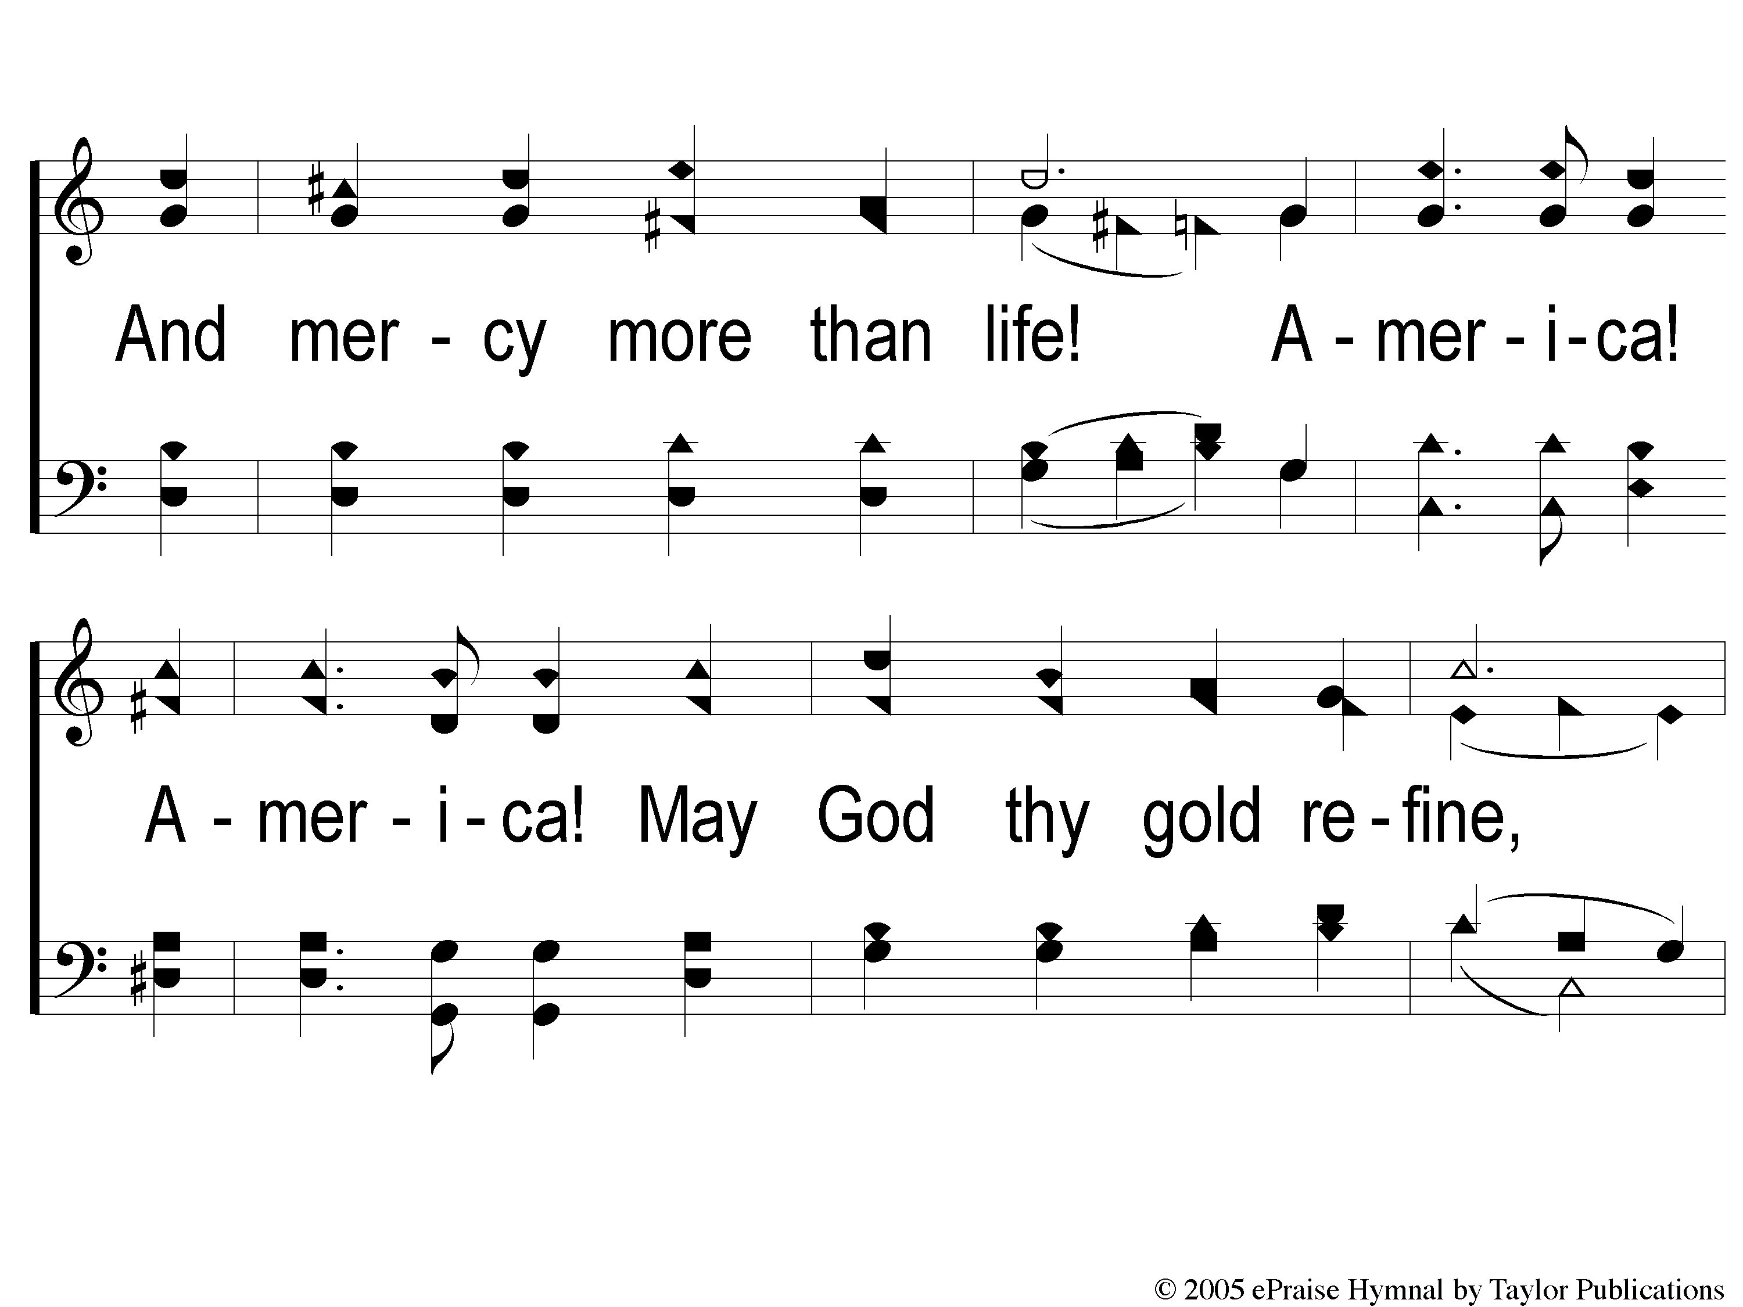
3-2 America The Beautiful
America The Beautiful
1007

Slide 9
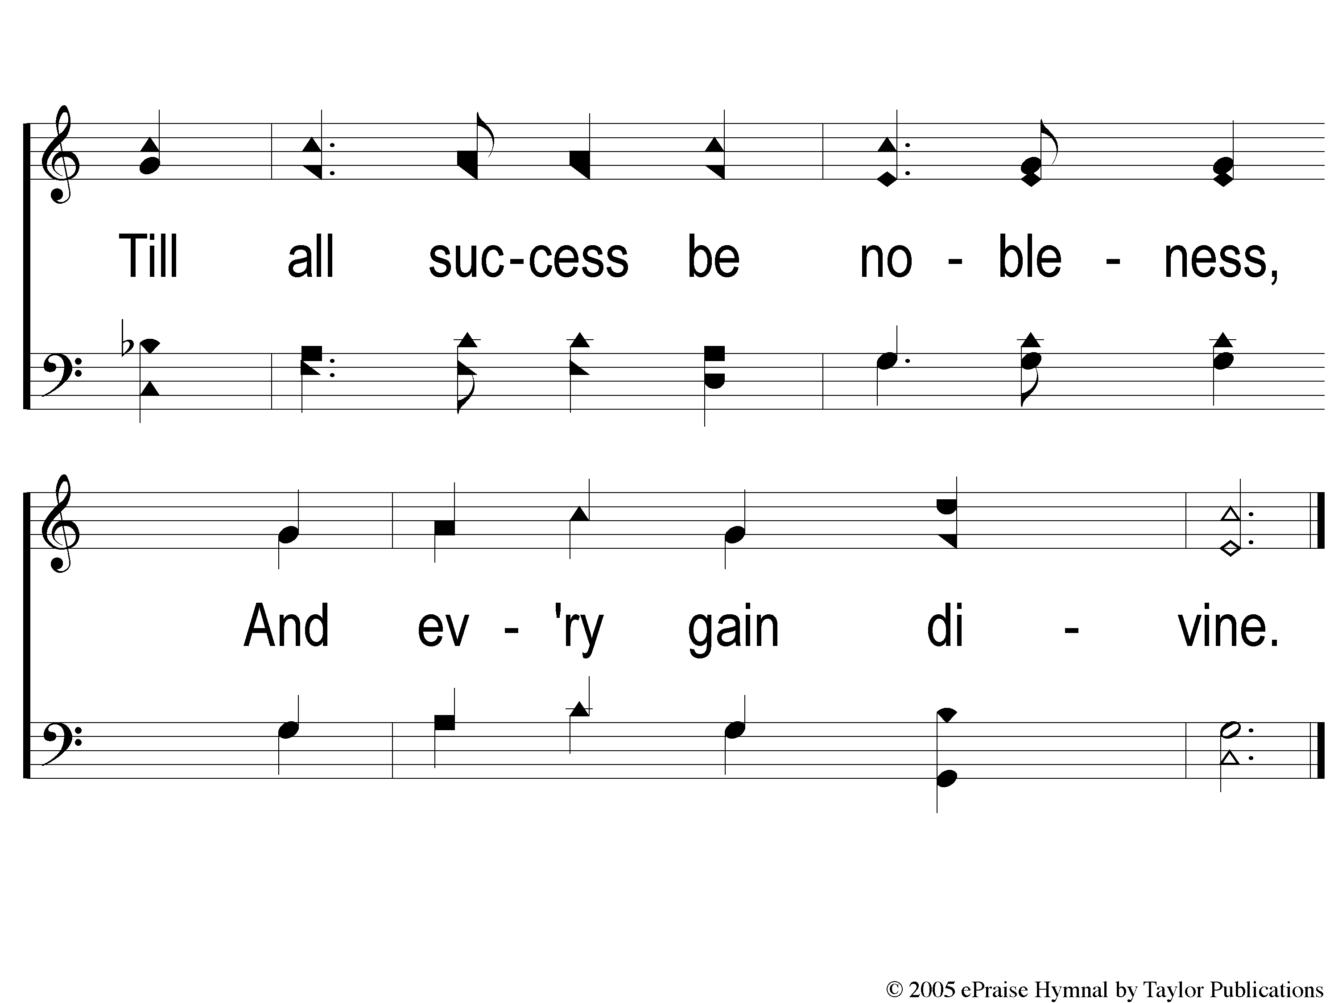
3-3 America The Beautiful
America The Beautiful
1007

Slide 10
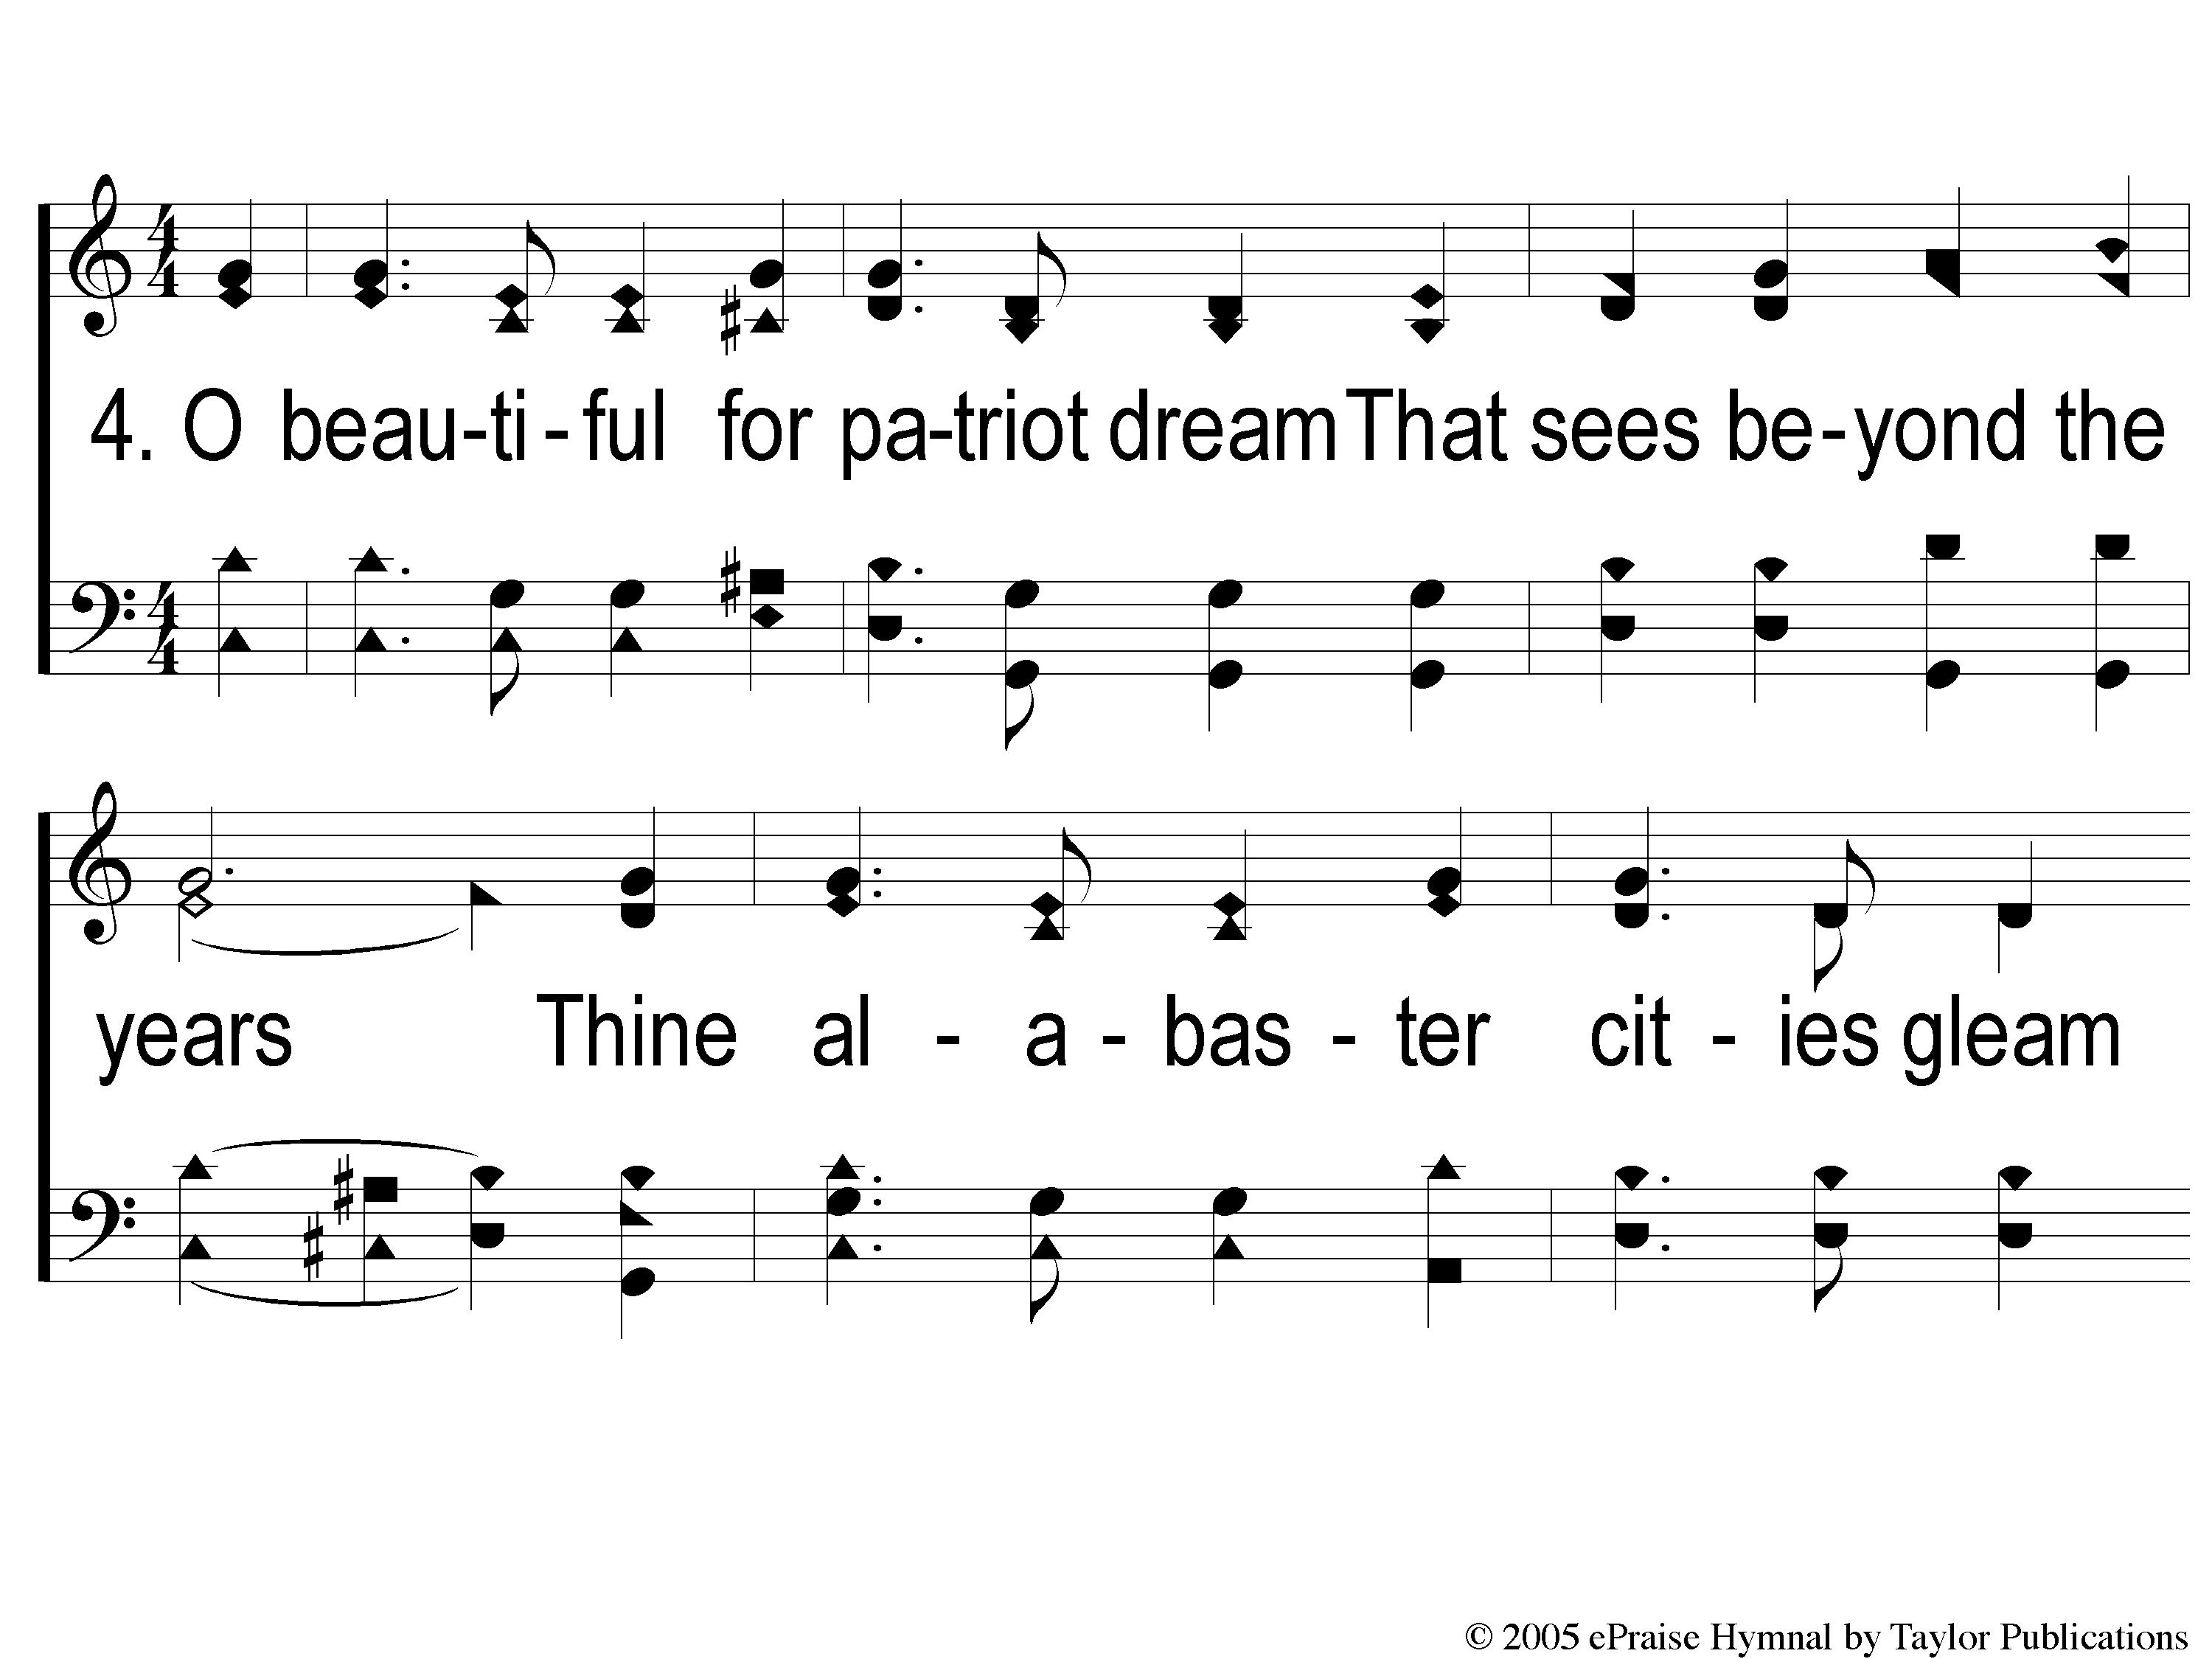
Opt descant 4-1 America The Beautiful
America The Beautiful
1007

Slide 11
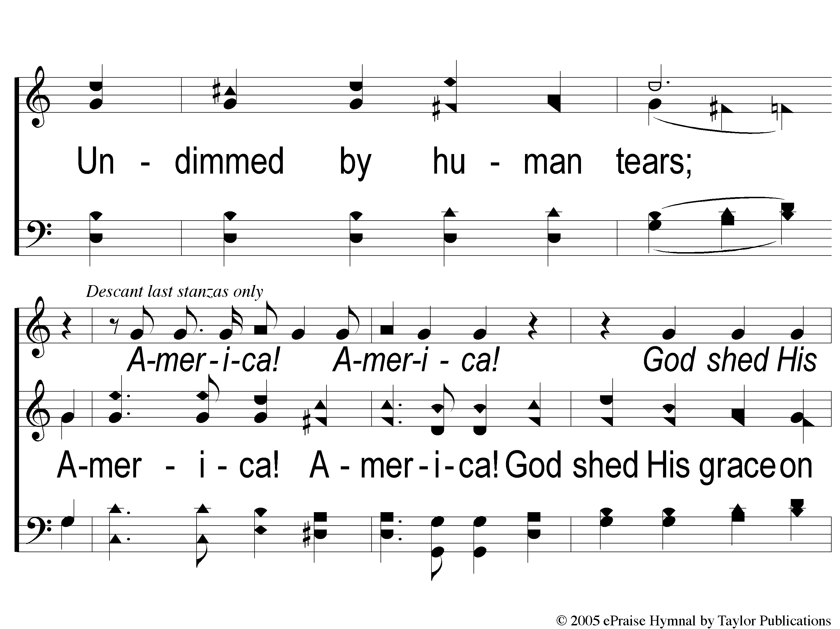
Opt descant 4-2 America The Beautiful
America The Beautiful
1007

Slide 12
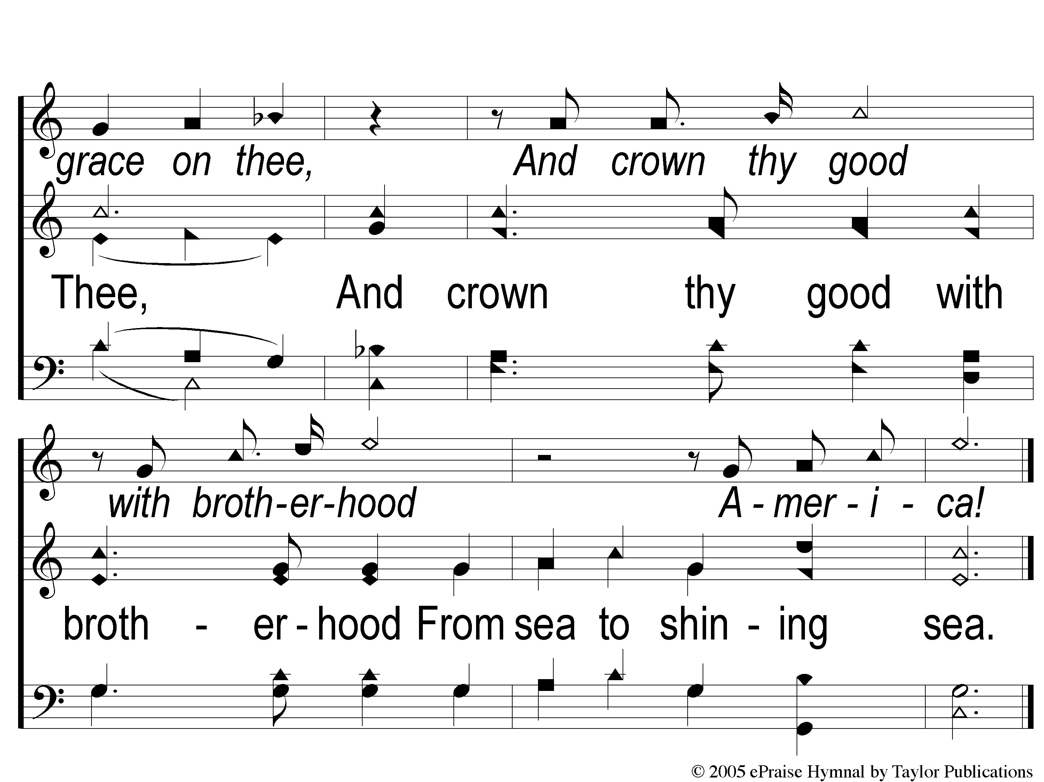
Opt descant 4-3 America The Beautiful
America The Beautiful
1007

